Slide 1

Javascript Unit 1
By Prof. Prasad Junghare

Slide 2
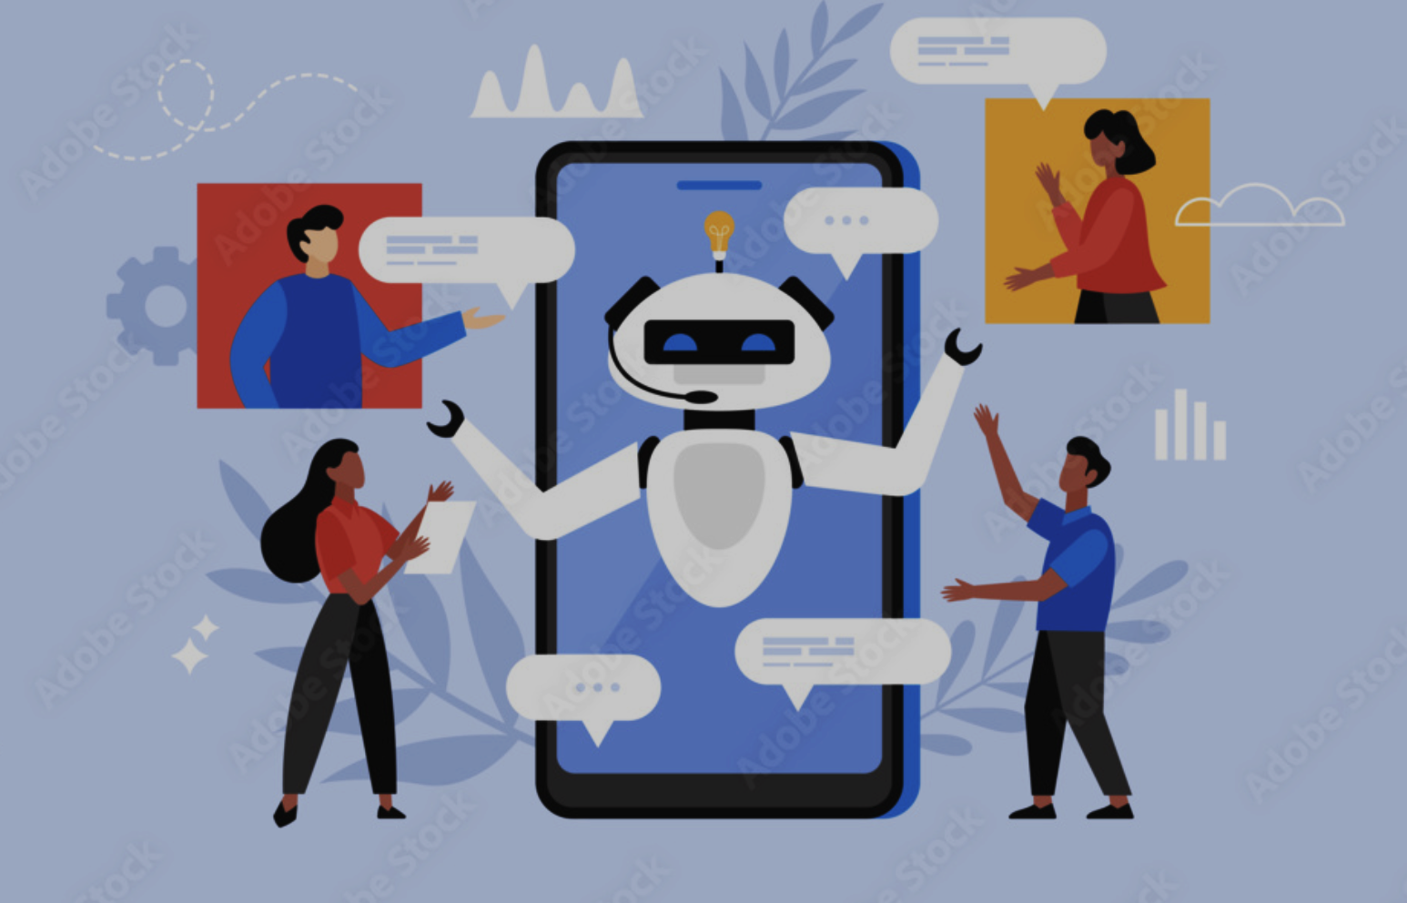

Simulated Customer Support Chat Bot
Problem Statement:
Hiring human representatives for 24/7 support has become expensive and time-consuming.
Customers often find waiting for email responses or human agents frustrating.
Proposed Solution:
Developed a browser-based chatbot using HTML, CSS, and JavaScript.
The bot analyzes user input via keyword matching and provides instant, predefined responses.
It assists users with common queries regarding orders, shipping, refunds, and payments.

Slide 3
Technical Implementation & Conclusion
Technology Stack:
HTML: Used to create the structure of the chatbot interface.
CSS: Used for styling with a modern dark theme and responsive layout.
JavaScript: Handles the logic, keyword matching, and DOM manipulation.
Key Features:
Asynchronous Delay: Uses setTimeout() to simulate a realistic “thinking” time before the bot replies.
Logic: Detects specific keywords (e.g., “refund”, “shipping”) and handles order numbers entered as digits separately.
Conclusion:
The project demonstrates that useful chat systems can be created using basic web technologies and predefined logic without needing advanced AI.
The chatbot successfully solves real-world delays by providing quick answers to common questions.

Slide 4
Thank You

